Slide 1
停車場盲區測距模組
C109152113 黃祥豪
C109152321 吳家穎
C109152148 黃俊瑋
C109152126 許哲逢
C109152127 何冠緯
C109152152 程霄雲
C109152204 陳信守

Slide 2
設計動機及目的:
日常在停車場常常因為環境，以及對場地不熟悉，所以我們設計一個可以感測距離以及是否有人經過，達到警示效果。
材料表:
材料 | 數量
HUB5168 | 1
蜂鳴器 | 2
LED | 4
DHT11 | 1
人體紅外線模組 | 1
超音波感測模組 | 1
電阻220 | 4

Slide 3
程式碼:
int distance = 0;
int cnt=0;
const int people_out=2;
char ssid[] = "D-Link_DIR-612"; // your network SSID (name)
char pass[] = "0986067099"; // your network password (use for WPA, or use as key for WEP)
// Name of the server we want to connect to
const char kHostname[] = "maker.ifttt.com";
String kBuffer = "/trigger/email_test/with/key/bpWMUhUdaVFz3Yk-0NGUCA?";
String kBuffer1 = "/trigger/people/with/key/bpWMUhUdaVFz3Yk-0NGUCA?";
const int kNetworkTimeout = 2 * 1000;
const int kNetworkDelay = 1000;
int status = WL_IDLE_STATUS;
long readUltrasonicDistance(int triggerPin, int echoPin)
{
digitalWrite(triggerPin, LOW);
delayMicroseconds(5);
// Sets the trigger pin to HIGH state for 10 microseconds
digitalWrite(triggerPin, HIGH);
delayMicroseconds(10);
digitalWrite(triggerPin, LOW);
// Reads the echo pin, and returns the sound wave travel time in microseconds
return pulseIn(echoPin, HIGH);// 收到高電位時的時間
}
#include <HttpClient.h>
#include <WiFi.h>
#include <WiFiClient.h>
#include "DHT.h"
//#define DHTPIN 8
//#define DHTTYPE DHT11 // DHT 11
//DHT dht(DHTPIN, DHTTYPE);
// tone 12 3
const int trigPin = 7; //Trig Pin
const int echoPin = 8; //Echo Pin
const int LED1_Pin = 10;
const int LED2_Pin = 11;
const int LED3_Pin = 9;
const int LED4_Pin = 6;

Slide 4
tone(3,900,1000);
delay(1000);
noTone(12);
noTone(3);
}
else if(distance < 20){
digitalWrite(LED1_Pin,HIGH);
digitalWrite(LED2_Pin,HIGH);
digitalWrite(LED3_Pin,LOW);
tone(12,400,250);
tone(3,400,250);
delay(250);
noTone(12);
noTone(3);
}
else if(distance < 30){
digitalWrite(LED1_Pin,HIGH);
digitalWrite(LED2_Pin,LOW);
digitalWrite(LED3_Pin,LOW);
}
else if(distance < 300){
digitalWrite(LED1_Pin,LOW);
digitalWrite(LED2_Pin,LOW);
digitalWrite(LED3_Pin,LOW);
}
// tone(12,560,2500);
Serial.print("Distance : ");
Serial.print(distance);
Serial.println("cm");
delay(50);
Transmit_data(distance,cnt,kBuffer);
}
else {
digitalWrite(LED1_Pin,LOW);
digitalWrite(LED2_Pin,LOW);
digitalWrite(LED3_Pin,LOW);
void setup() {
Serial.begin(115200);
//dht.begin();
pinMode(trigPin, OUTPUT);
pinMode(echoPin, INPUT);
pinMode(LED1_Pin, OUTPUT);
pinMode(LED2_Pin, OUTPUT);
pinMode(LED3_Pin, OUTPUT);
pinMode(LED4_Pin, OUTPUT);
pinMode(people_out, INPUT);
while (status != WL_CONNECTED) {
Serial.print("Attempting to connect to SSID: ");
Serial.println(ssid);
status = WiFi.begin(ssid, pass);
// wait 10 seconds for connection:
delay(10000);
}
Serial.println("Connected to wifi");
printWifiStatus();
}
void loop() {
/*float h = 2.2;
float t = 2.3;
*/
/*float h = dht.readHumidity();
float t = dht.readTemperature();
// Check if any reads failed and exit early (to try again).
if (isnan(h)|| isnan(t) ) {
Serial.println(F("Failed to read from DHT sensor!"));
return;
}*/
if(digitalRead(people_out)){
digitalWrite(LED4_Pin,HIGH);
distance = 0.01723 * readUltrasonicDistance(trigPin, echoPin);
if(distance < 10){
digitalWrite(LED1_Pin,HIGH);
digitalWrite(LED2_Pin,HIGH);
digitalWrite(LED3_Pin,HIGH);
tone(12,900,1000);

Slide 5
} else {
delay(kNetworkDelay);
}
}
}
}
}
http.stop();
}
void Transmit_data1(String API_Path){
int err = 0;
char kPath[128];
String url_s =API_Path ;
url_s.toCharArray(kPath,url_s.length() + 1);
WiFiClient c;
HttpClient http(c);
err = http.get(kHostname, kPath);
if (err == 0) {
Serial.println("startedRequest ok");
err = http.responseStatusCode();
if (err >= 0) {
Serial.print("Got status code: ");
Serial.println(err);
err = http.skipResponseHeaders();
if (err >= 0) {
int bodyLen = http.contentLength();
Serial.print("Content length is: ");
Serial.println(bodyLen);
Serial.println();
Serial.println("Body returned follows:");
unsigned long timeoutStart = millis();
char c;
while ((http.connected() || http.available()) && ((millis() - timeoutStart) < kNetworkTimeout)) {
if (http.available()) {
c = http.read();
Serial.print(c);
bodyLen--;
timeoutStart = millis();
} else {
delay(kNetworkDelay);
}
}
}
}
}
http.stop();
}
void printWifiStatus() {
// print the SSID of the network you're attached to:
Serial.print("SSID: ");
Serial.println(WiFi.SSID());
// print your WiFi shield's IP address:
IPAddress ip = WiFi.localIP();
Serial.print("IP Address: ");
Serial.println(ip);
// print the received signal strength:
long rssi = WiFi.RSSI();
Serial.print("signal strength (RSSI):");
Serial.print(rssi);
Serial.println(" dBm");
}
digitalWrite(LED4_Pin,LOW);
Transmit_data1(kBuffer1);
}
delay(1000);
cnt++;
}
void Transmit_data(float h ,float t ,String API_Path){
int err = 0;
char kPath[128];
String url_s =API_Path + "value1=" + (int)t + "number&value2=" + (int)h + "cm";
url_s.toCharArray(kPath,url_s.length() + 1);
WiFiClient c;
HttpClient http(c);
err = http.get(kHostname, kPath);
if (err == 0) {
Serial.println("startedRequest ok");
err = http.responseStatusCode();
if (err >= 0) {
Serial.print("Got status code: ");
Serial.println(err);
err = http.skipResponseHeaders();
if (err >= 0) {
int bodyLen = http.contentLength();
Serial.print("Content length is: ");
Serial.println(bodyLen);
Serial.println();
Serial.println("Body returned follows:");
unsigned long timeoutStart = millis();
char c;
while ((http.connected() || http.available()) && ((millis() - timeoutStart) < kNetworkTimeout)) {
if (http.available()) {
c = http.read();
Serial.print(c);
bodyLen--;
timeoutStart = millis();

Slide 6
產品設計功能:
利用人體紅外線模組偵測是否有人，如果有人才會偵測距離，根據距離長短，蜂鳴器會呈現不同的音量。
最終將所有感測資料透過HUB 5168+連接到手機的Line來達成提醒的動作，同時利用樹梅派來監測環境的溫濕度。

Slide 7
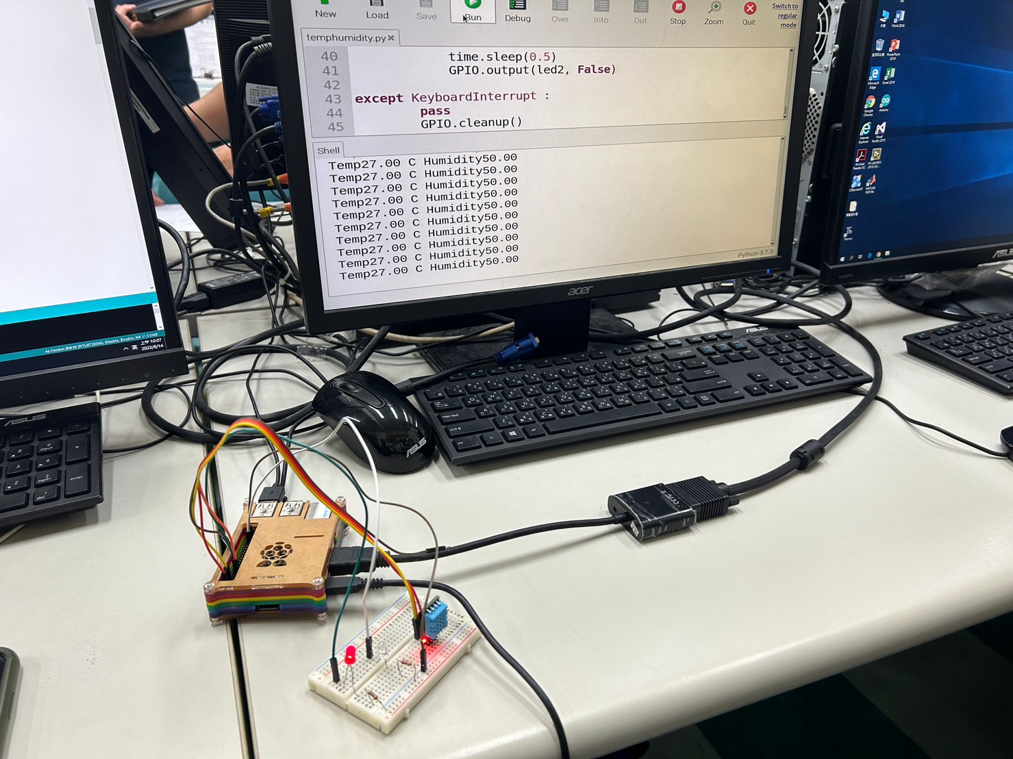
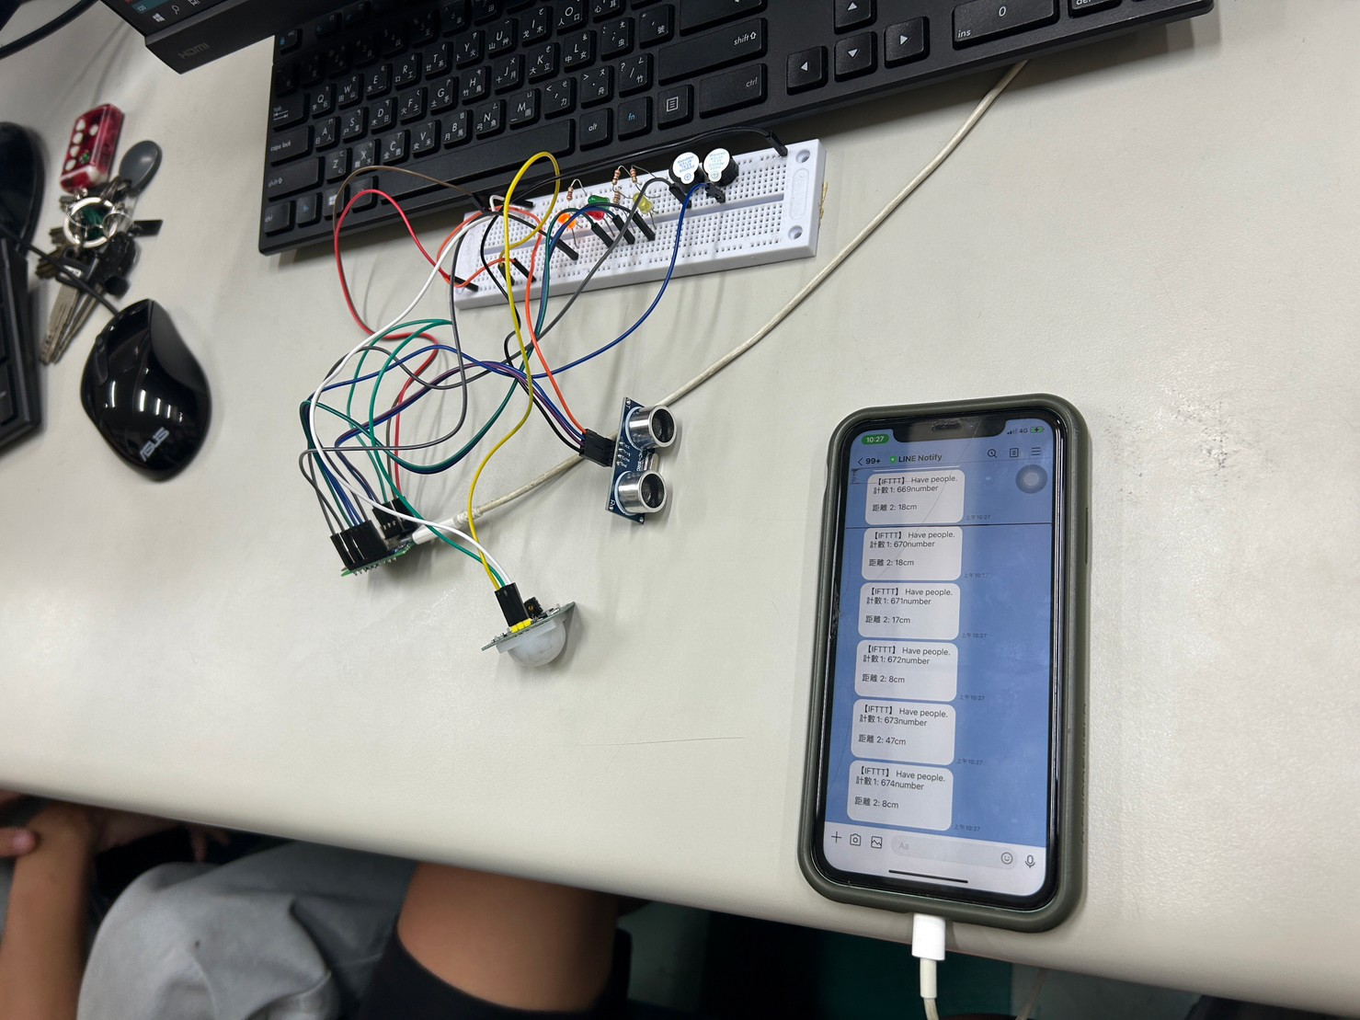
樹梅派
監測環境的溫度及濕度
利用人體紅外線模組偵測是否有人，並根據距離蜂鳴器聲量會不同，將所有感測資料透過HUB 5168+連接到手機的Line來達成提醒效果

